Slide 1
EIT x Soft Robots: project update
Week of Monday 05/07/2021

Slide 2
Things to do/I’m doing
Do multiple iterations of actuator tests to gather more data
Refine actuator design (new moulds, iterate on actuator until a satisfactory design)
Work on OpenCV point tracking to get ground truth data
Investigate ML solutions for control problem (possibly just with voltages, may need full EIT images)

Slide 3
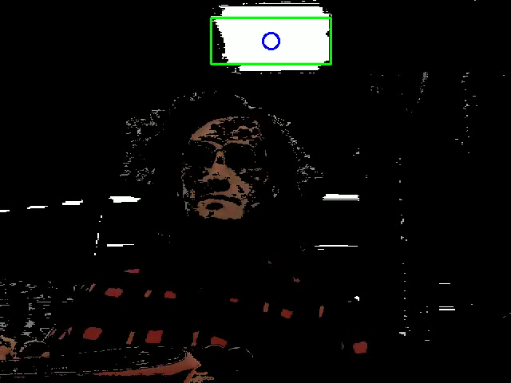
OpenCV color tracking
Able to register color shape in frame
Must improve tracking, enable detection of smaller and multiple objects in same frame

Slide 4
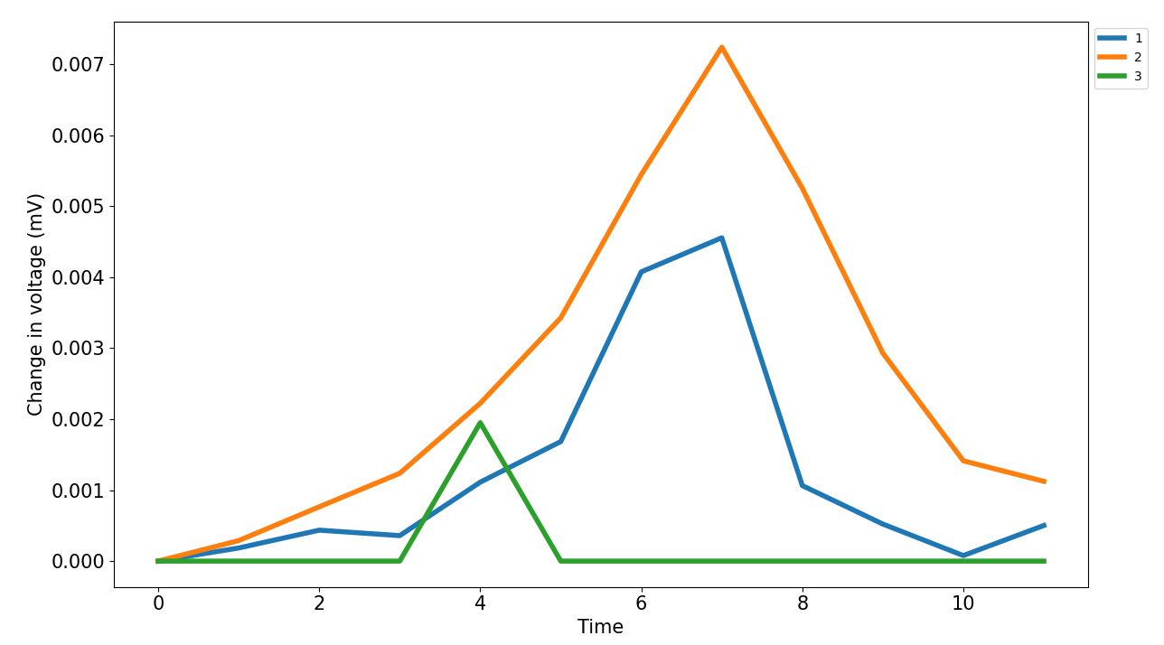
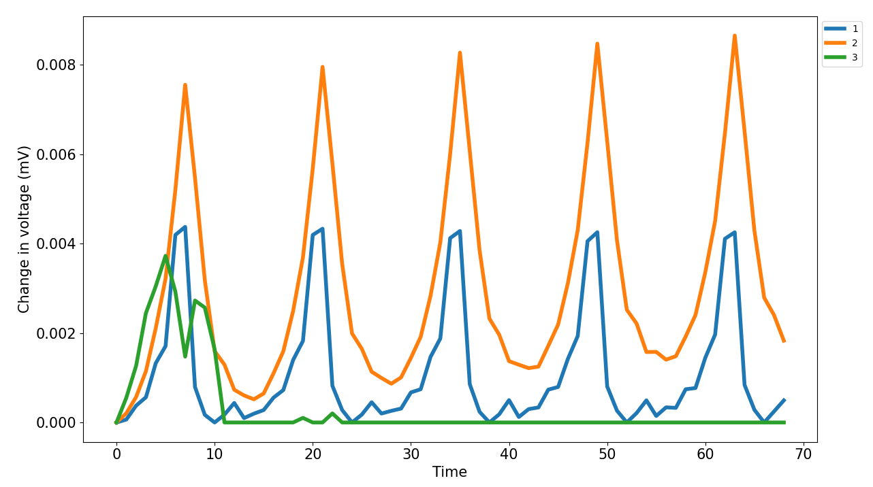
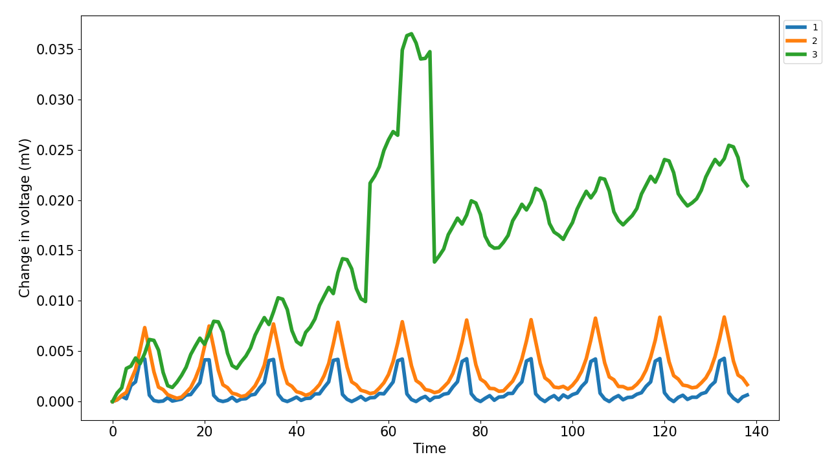
EIT data of SDM actuator in stepper rig
1 iteration
5 iterations
10 iterations

